Slide 1

UI / UX Web Development Solutions
Innovating Digital Experiences with AI
Sana Faisal
Founder & CEO

Slide 2
About Me
Hello! I’m Sana Faisal, a results-driven UI/UX Developer passionate about creating beautiful, user-friendly websites and web applications. With expertise in HTML, CSS, Tailwind CSS, JavaScript, TypeScript, Next.js, APIs Development, Node.js, and more, I bring a versatile skill set to every project.
I’m also proficient in Figma, Adobe Photoshop, SEO, Responsive Design, and deploying sites via GIT and Vercel. I focus on building responsive, high-performance websites that deliver seamless experiences across all devices.
Let me help you bring your digital vision to life with creativity and precision!

Slide 3
Service Offered
I provide a comprehensive suite of Front-End Development services designed to meet your business needs:
Custom Development:
Clean, scalable code using HTML, CSS, JavaScript, TypeScript, ensuring optimal functionality and design.
Responsive Web Design:
Fully responsive websites built with Tailwind CSS, Next.js, and modern frameworks for all devices.
API Integration:
Seamless development and integration for dynamic websites that interact with external data sources.
CMS Integration:
Flexible content management solutions using WordPress, Shopify, or custom CMS.
SEO & Optimization:
Enhancing search engine rankings and performance with best-in-class SEO and speed optimization.

Slide 4
Service Offered
I provide a comprehensive suite of Front-End Development services designed to meet your business needs:
E-Commerce Solutions:
Secure, intuitive e-commerce sites designed for seamless user experiences and conversion.
UI/UX Design:
Engaging, intuitive interfaces that enhance user experience and drive results.
Testing & Debugging:
Comprehensive testing across devices and browsers, ensuring flawless performance.
Version Control & Deployment:
Efficient code management with Git, and quick deployment through Vercel.
Performance Tuning:
Optimizing websites for faster load times and better performance, ensuring a smooth user experience even during high traffic.

Slide 5
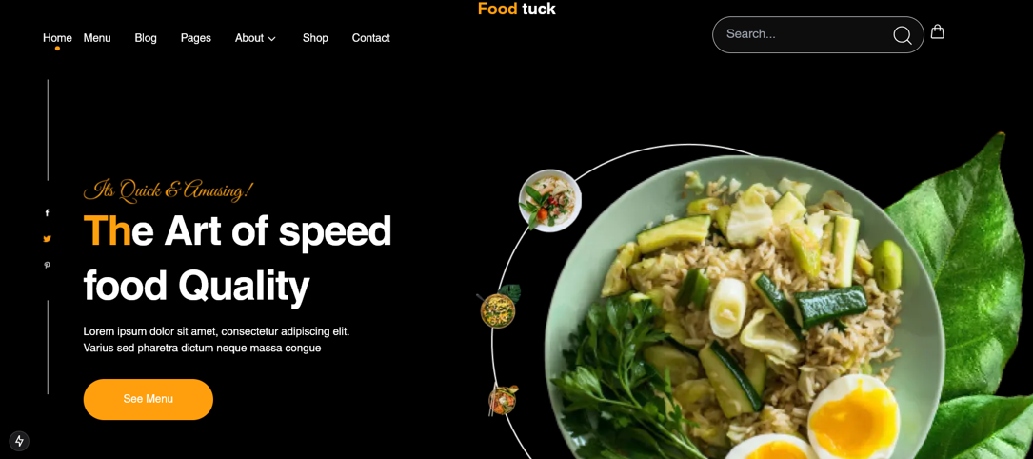
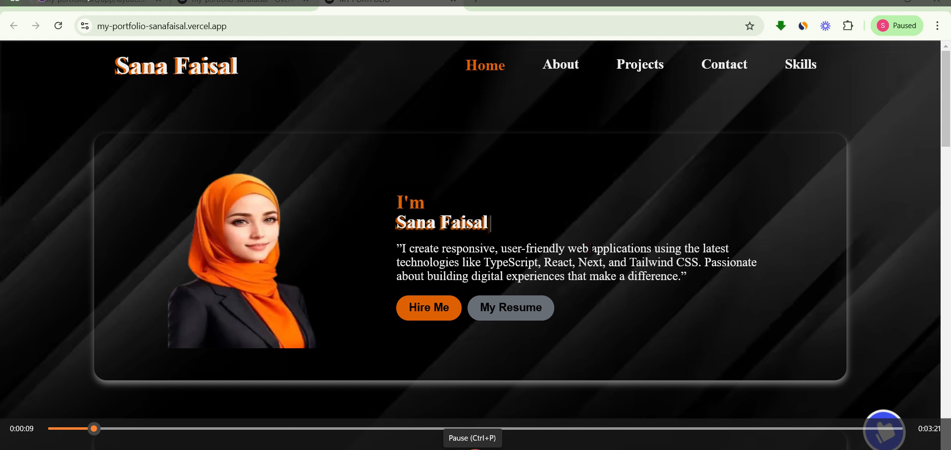
Portfolio Highlights
Over the years, I have successfully delivered numerous projects that not only meet client expectations but also drive tangible results. Here are some of my best works:
Project 1: Q-Commerce Website for [ Food-Tuck ]
Project 2: Portfolio Website
Technologies: Next.Js, Tailwind CSS, Figma (Design), CMS, APIs Integration, GIT & Vercel (Deployment).
Overview: A custom-built, fully responsive Q-commerce platform optimized for performance and user experience.
Achievement: Increased sales by 30% in 3 months through seamless user navigation and optimized checkout process.
Technologies: HTML, CSS, JavaScript, Next.Js, Tailwind CSS, Figma (Design), APIs Integration, Vercel (Deployment).
Overview: A sleek and modern portfolio website designed to showcase the client’s work and services.
Achievement: Delivered a sharp, interactive design with an emphasis on quick load times and mobile-first responsiveness.

Slide 6
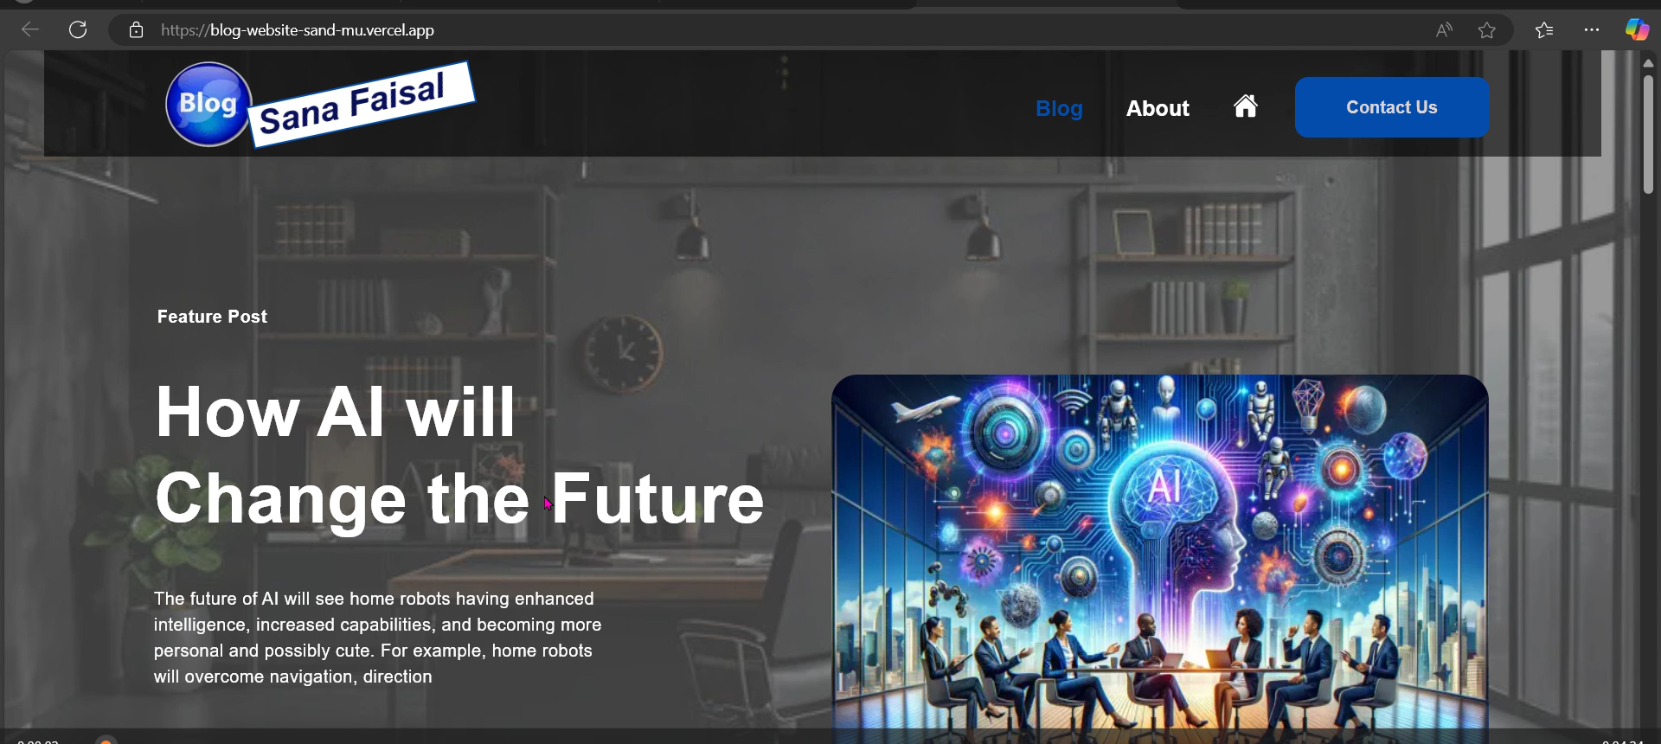
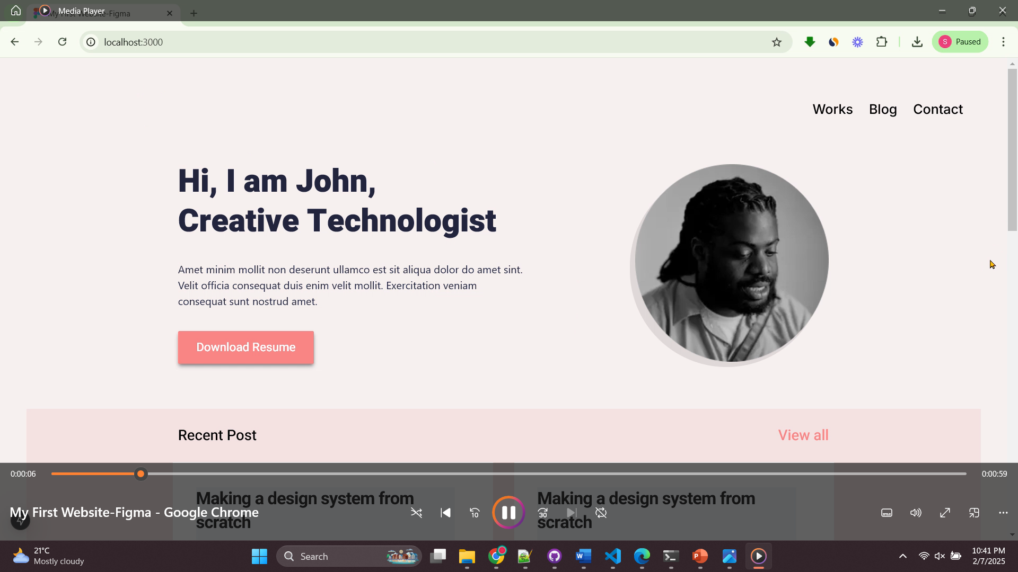
Portfolio Highlights
Project 3: Custom Blog Website [ with CMS Integration ]
Project 4: Portfolio Website (Design for Figma)
Technologies: Next.Js, Tailwind CSS, Figma (Design), GIT & Vercel (Deployment).
Overview: A blog website with dynamic features.
Achievement: Boosted site traffic by 40% due to better content accessibility and SEO optimization.
Technologies: Next.Js, Tailwind CSS, Figma (Design), GIT & Vercel (Deployment).
Overview: A blog website with dynamic features.
Achievement: Boosted site traffic by 40% due to better content accessibility and SEO optimization.

Slide 7
Client Testimonials
MR. SAMEER KHAN
Manager Food-Tuck
SEEMI SAQIB
Director
KASHIF NASEER
IT Manager
Miss Sana expertise in Next.js and Tailwind CSS transformed our website into a high-performance platform.
Her attention to detail and commitment to quality is unmatched.
Miss Sana has delivered our project on time, exceeding our expectations.
Her skills in API integration and SEO optimization resulted in increased traffic and conversions.
I highly recommend Miss Sana for any front-end development needs. Her proficiency in HTML/CSS, Next.Js, and CMS integration helped us create a smooth, efficient website with a fantastic user interface.

Slide 8
Process & Methodology
My development process is streamlined and designed to ensure efficiency, high-quality results, and client satisfaction. Here’s a breakdown of how I approach each project:
Discovery & Consultation:
We begin with a detailed consultation to understand your business goals, target audience, and project requirements. This establishes a clear vision for the website or application.
Project Scope Definition:
After understanding your needs, I define the project scope, deliverables, timelines, and key milestones to ensure alignment with your expectations..
Wireframing & Design:
Using Figma, I create wireframes and prototypes based on your feedback. This ensures user-centric design and that your brand identity is incorporated effectively.
Design Approval:
Once the wireframes and designs are finalized, I get your approval to move forward. This step ensures that the design vision meets your expectations before development begins.
Front-End Development:
I start developing the front-end using modern technologies like Next.js, Tailwind CSS, and JavaScript/TypeScript to ensure a responsive, fast, and scalable website.

Slide 9
Process & Methodology
API & CMS Integration:
For dynamic functionality, I integrate APIs and CMS solutions, enabling easy content management and enhancing website performance.
Quality Assurance:
I perform thorough testing to ensure the website is responsive, error-free, and optimized across all devices, browsers, and screen sizes..
Performance & Security Optimization:
During testing, I optimize website performance and security, ensuring fast load times and protection against vulnerabilities.
Deployment & Launch:
After successful testing, I deploy the website on trusted platforms like Vercel for fast and secure launches, managing domain settings and DNS configuration.
Support & Maintenance:
Post-launch, I offer ongoing support for updates, troubleshooting, and any adjustments to ensure the website continues to perform optimally.

Slide 10
Pricing Plan
Basic Package
Standard Package
Premium Package
This Package is Ideal for small businesses or personal websites.
This Package is Ideal for small businesses or personal websites.
For businesses needing a comprehensive solution with dynamic features.
Features:
Up to 3 Pages a
Responsive Design a
Basic SEO Setup a
Contact Forms a
Deployment via Vercel a
Social media integration r
Deployment and testing r
Price: $250
Features:
Up to 7 Pages a
Custom Design and Layout a
CMS Integration a
Advanced SEO a
Blog Integration a
Social Media Integration a
Deployment and Testing a
Price: $400
Features:
8+ Pages a
Custom API integrations a
E-commerce Functionality a
Performance Optimization a
User authentication a
Full-scale SEO strategy a
Support and Maintenance a
Price: $600

Slide 11

Are you ready to take your digital presence to the next level?
Let’s work together to create a website that truly reflects your brand’s identity and engages your audience.
Get in touch today to discuss your project and get a free consultation.

Slide 12
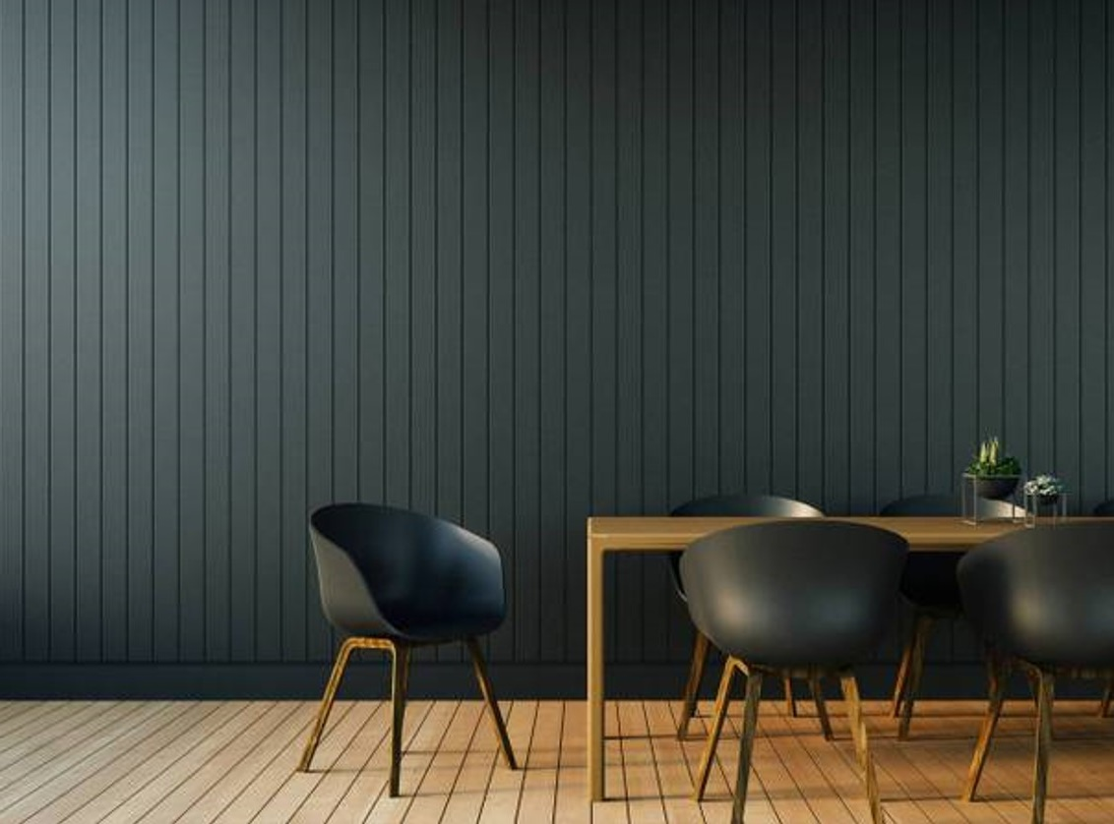
Thank you
Sana Faisal
Sana.faisalmehmood@gmail.com

